Slide 1

Topographical Data Analysis
Austin Downey
Assistant Professor, Department of Mechanical Engineering
Assistant Professor, Department of Civil and Environmental Engineering
Notes:
1

Slide 2
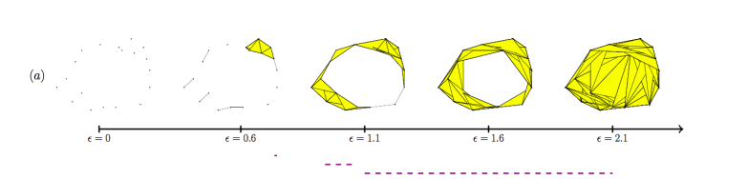
Topological Data Analysis
A few things to consider
I have no idea how to get this to work with a linear algebra approach.
I can find 1-simplex, all others are a mystery.
Clueless how to get H₁, I think I get H₀.
How do 1-simplex (or any simplex) die?
A Roadmap for the Computation of Persistent Homology
Notes:
2

Slide 3
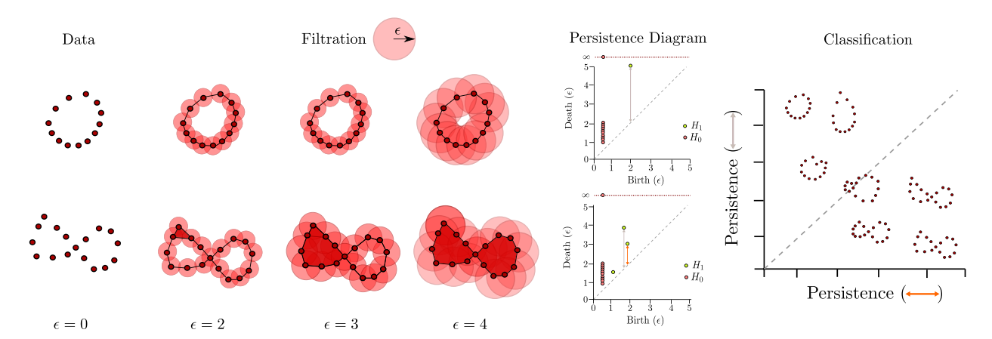
Topological Data Analysis
H₁ and H₀.
Topological Data Analysis: Concepts, Computation, and Applications in Chemical Engineering
Notes:
3

Slide 4
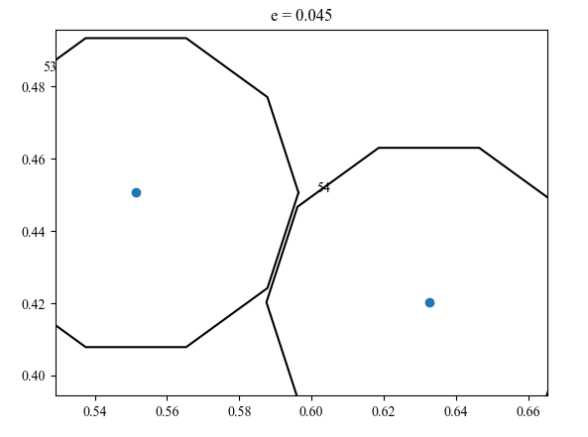
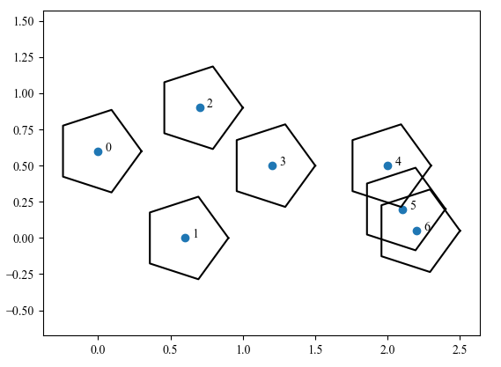
Topographical Data Analysis
No real circles
I build polygons, and check if they overlap. This does not always work.
Notes:
4

Slide 5
Mackey Glass Data

Slide 6
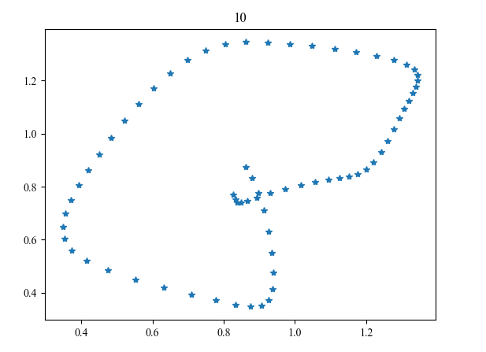
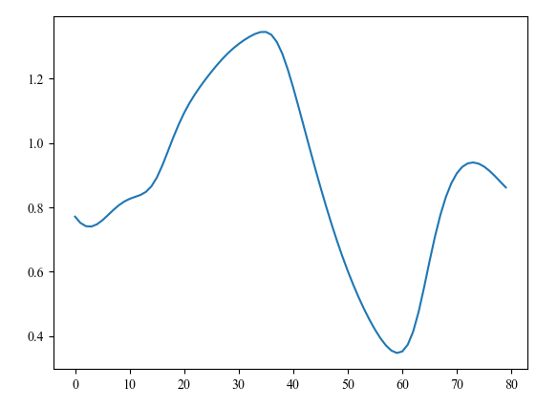
Mackey Glass Data

Slide 7
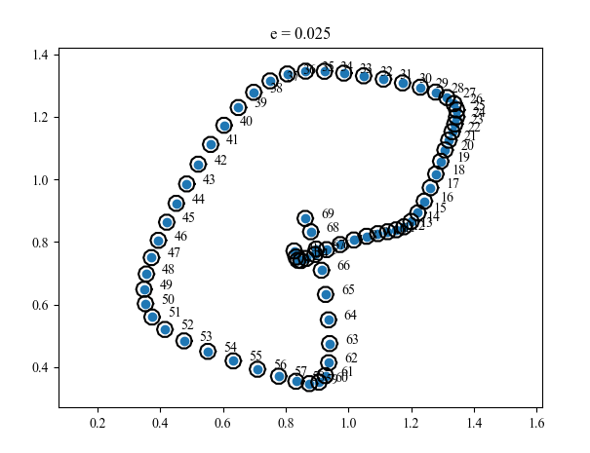
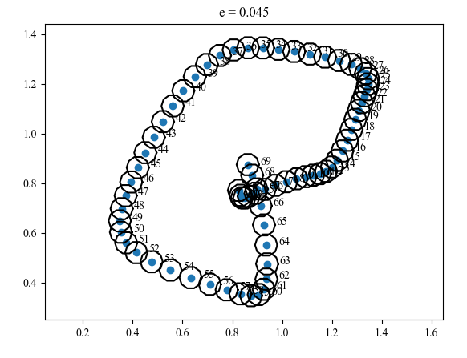

Slide 8
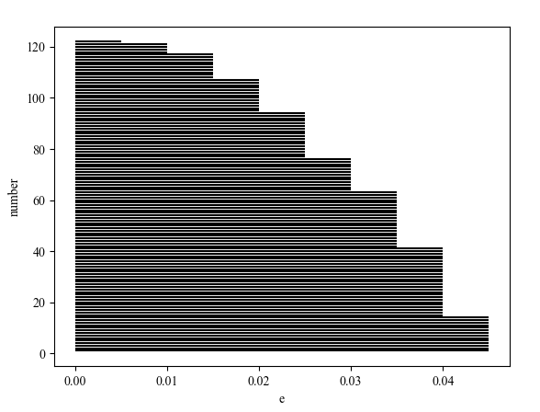
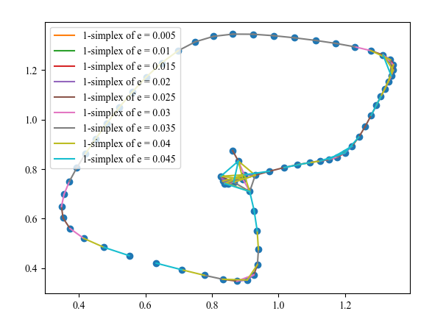
Barcode plots

Slide 9
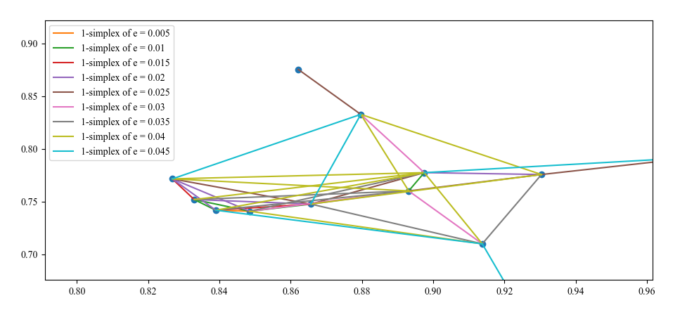

Slide 10
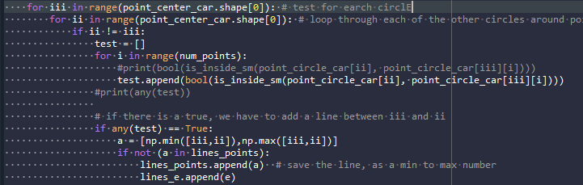
Code for a single “e”

Slide 11
Air Force Data

Slide 12
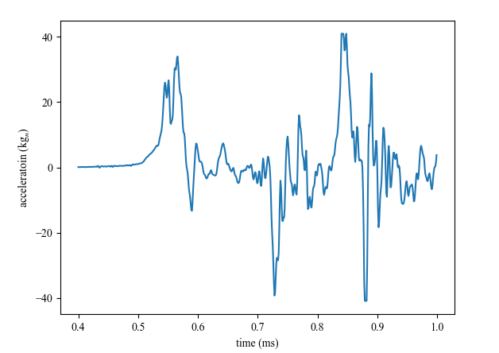
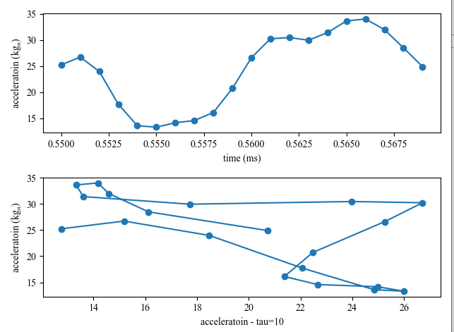
Window a small set of the data

Slide 13
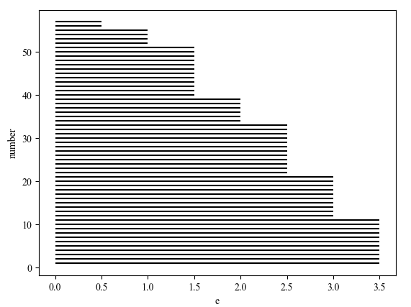
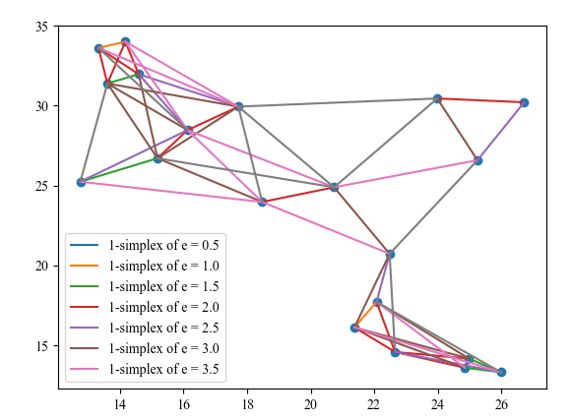
10 point circle, tau = 10

Slide 14
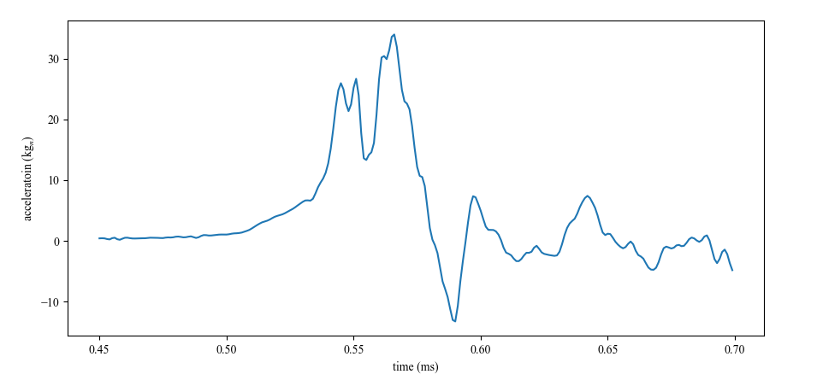
Tracking e over time

Slide 15
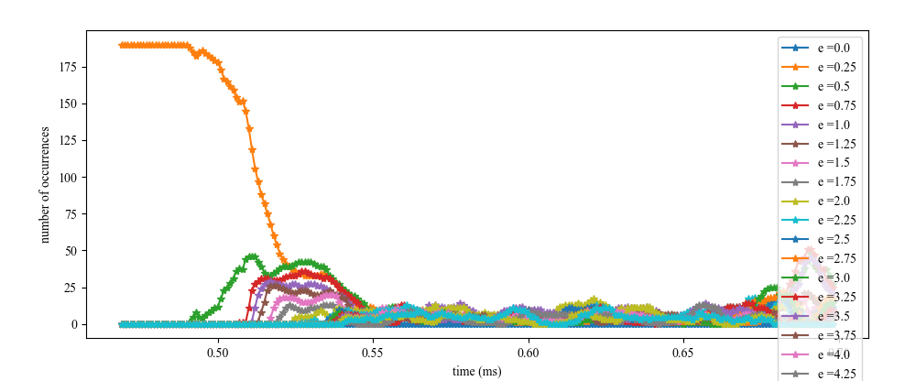
Tracking e over time

Slide 16
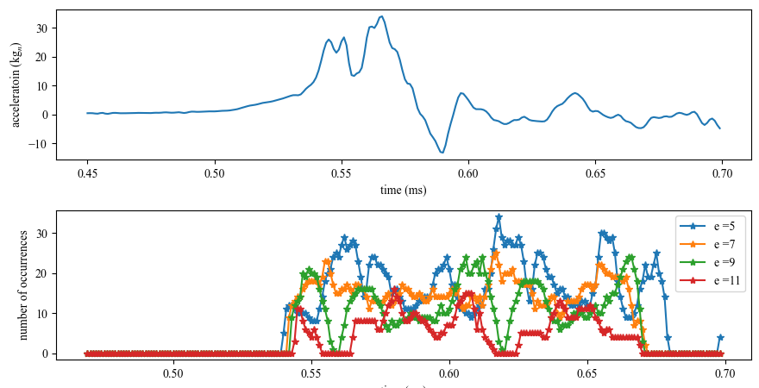
Maybe more info in higher e

Slide 17
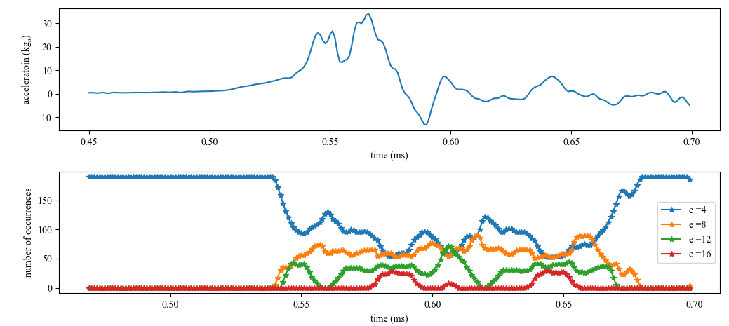
Sparce e spacing

Slide 18
Euclidean distance method

Slide 19
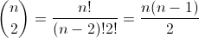
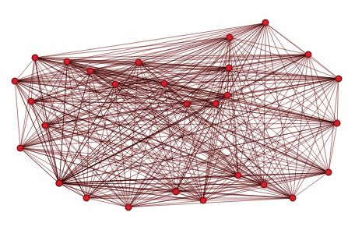
Mathematical complexity
To find the number of connections, the solution is combinatorial: The problem is equivalent to the number of possible pairs of nodes in the graph, i.e.:
So, I think this is Quadratic Time: O(n²)

Slide 20
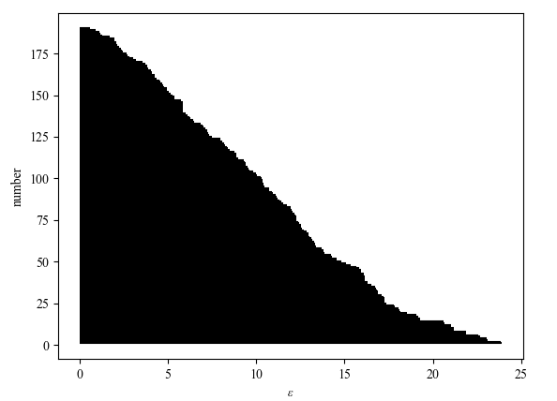
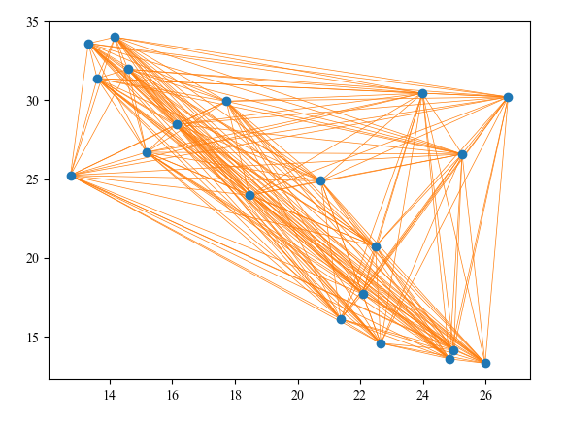
Combinatorial

Slide 21
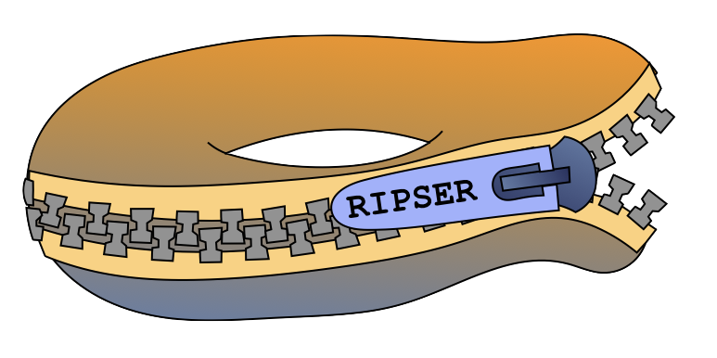
Giving up on my code, moving to scikit-tda and Ripser

Slide 22
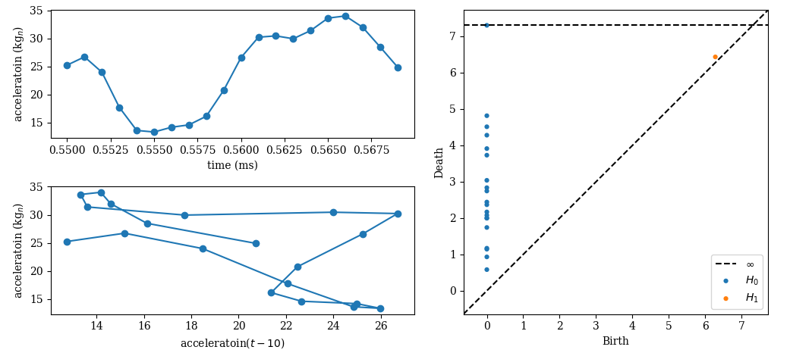
Easy, but not what I expected!

Slide 23
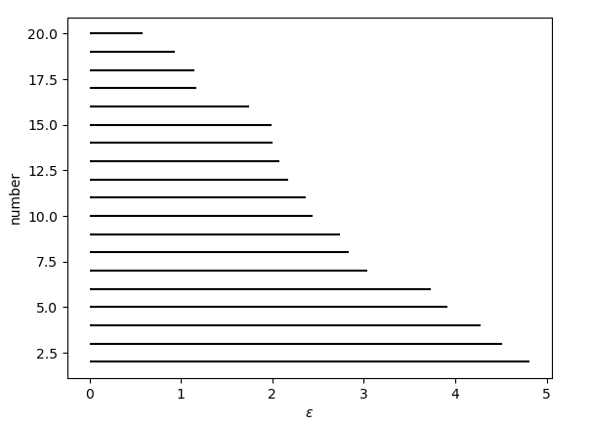
Easy, but not what I expected!
I don’t understand why they are all born at 0?
How is anything born at 0, don’t they have to connect?
My barcode plot seems to be small, why so few items?

Slide 24
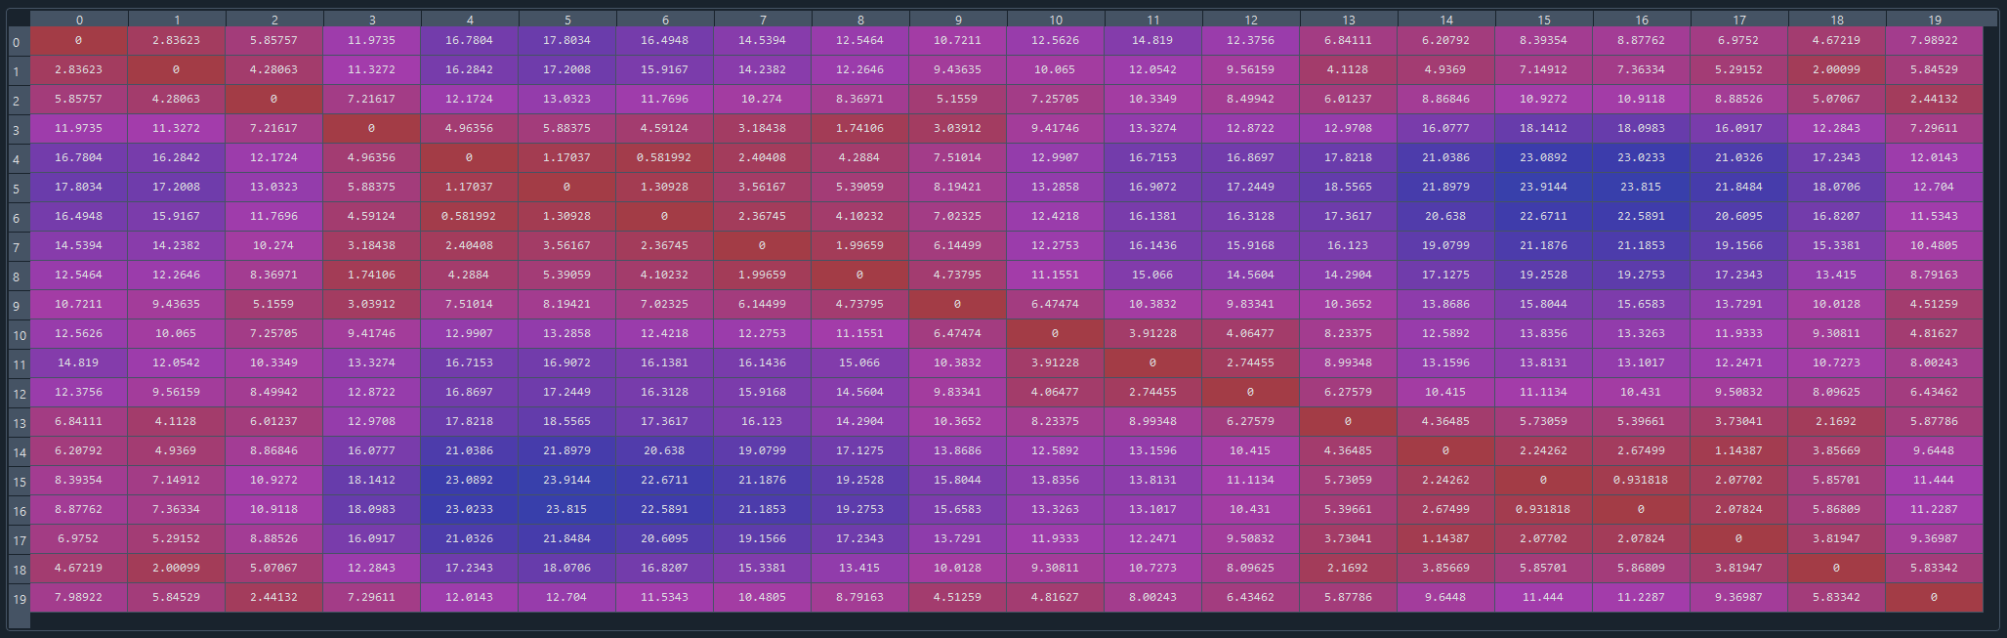
Dperm2all (The distance matrix used during the computation)

Slide 25
Computational Efforts
n_perm (int, optional, default None) – The number of points to subsample in a “greedy permutation,” or a furthest point sampling of the points. These points will be used in lieu of the full point cloud for a faster computation, at the expense of some accuracy, which can be bounded as a maximum bottleneck distance to all diagrams on the original point set

Slide 26
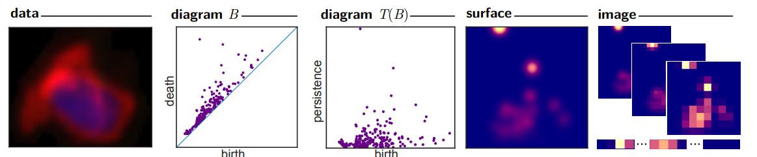
Persistence Images: A Stable Vector Representation of Persistent Homology

Slide 27
I like the idea of “Persistence Images”
From the paper Adams, Henry, et al. "Persistence images: A stable vector representation of persistent homology." Journal of Machine Learning Research 18 (2017).
Would be a great tool for classification. A CNN could quickly classify damage from a resistance image.

Slide 28
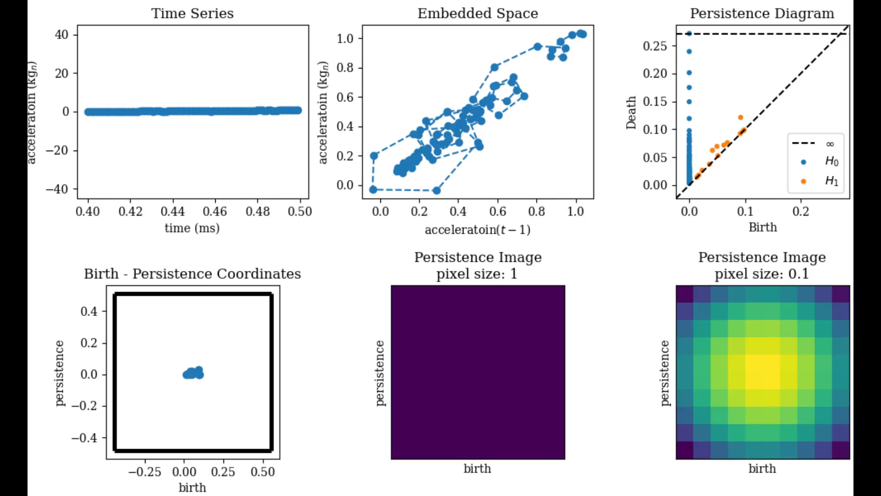
Air Force Data Tau=1

Slide 29
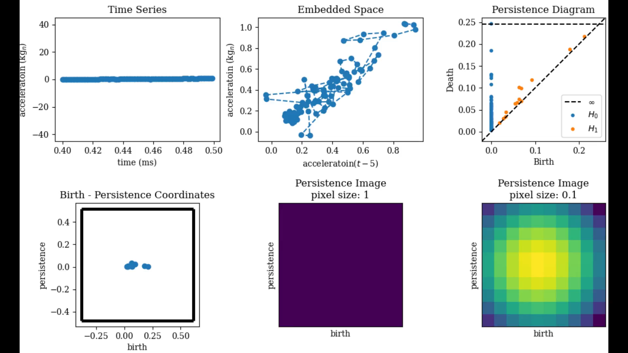
Air Force Data Tau=5

Slide 30

Air Force Data Tau=10

Slide 31
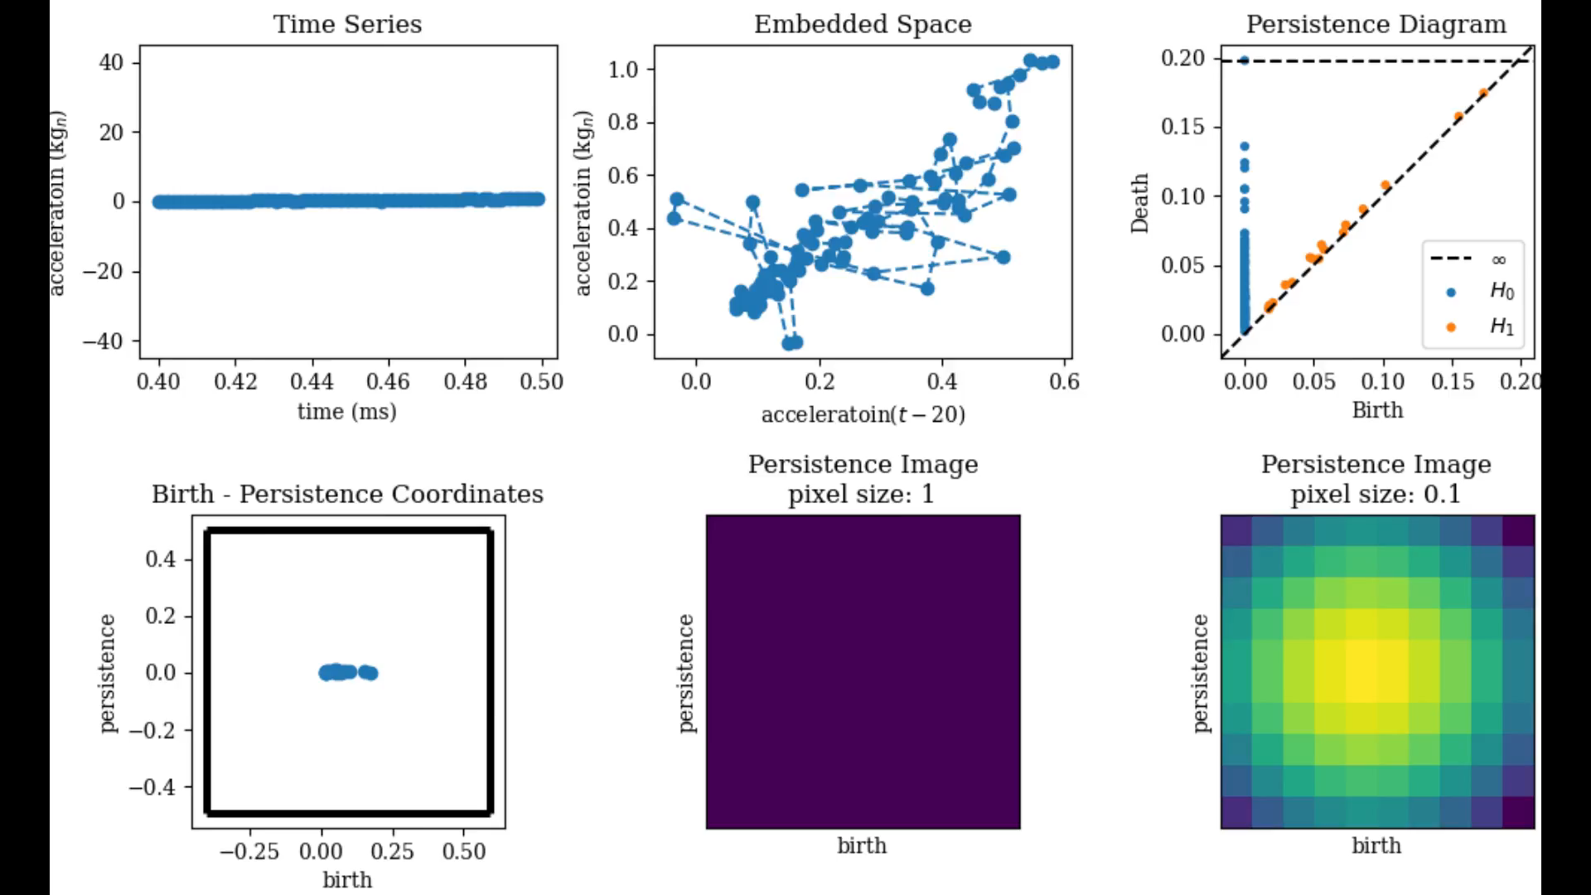
Air Force Data Tau=20

Slide 32
Thanks!
Contact Information
Email: xxx
Github: xxx
Social: xxx

